Slide 1
Mirror Descent: from theory to practice
Danya Merkulov

Slide 2
Introduction
Notes:
Сюжеты:
Что такое PGD, скорости сходимости, постановки задач Обобщение на случай другого расстояния: MD Natural Gradient MD = NG
Пример, когда MD должен работать лучше Обзор последних статей на тему * Linear Coupling * https://web.stanford.edu/~jduchi/projects/DuchiAgJoJo12.pdf
* http://papers.nips.cc/paper/5843-accelerated-mirror-descent-in-continuous-and-discrete-time.pdf

Slide 3
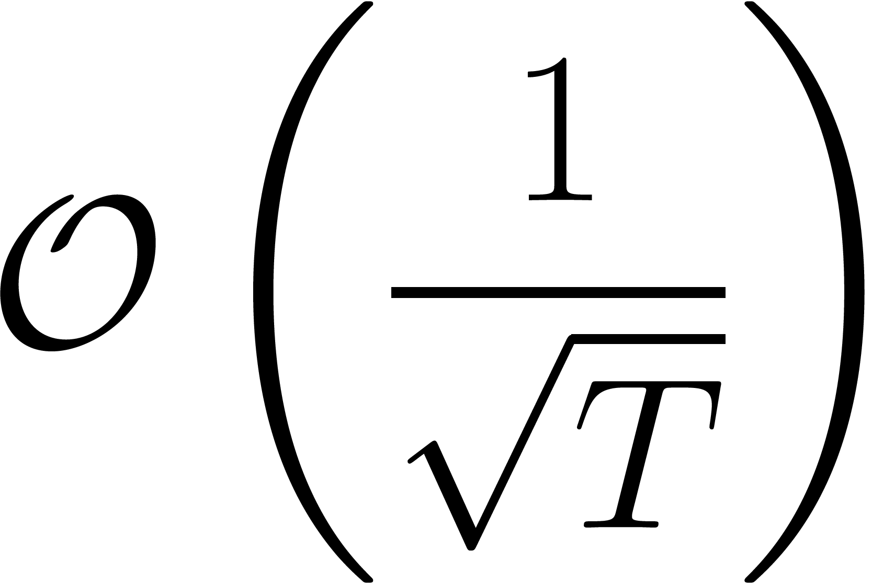
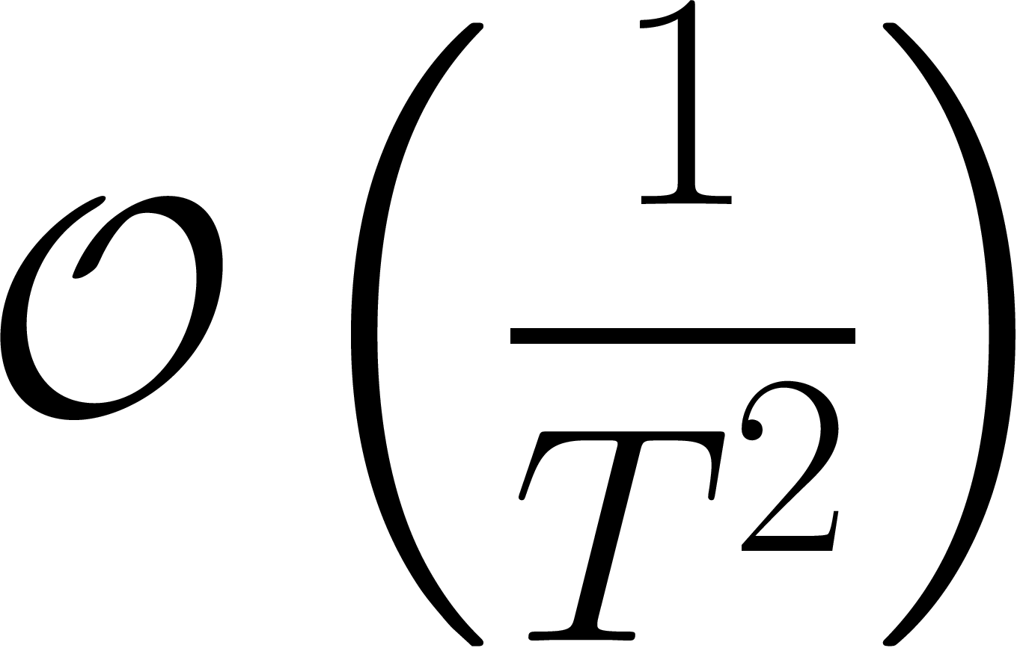
Theory vs Practice in 1st order stochastic optimization in NN
Theory
Optimal 1st order algorithm – mirror descent with rates:
Non – smooth
Smooth
Practice
Non smooth (even non convex), but usually
Various variants of SGD are used (Adagrad, Adam, RMSProp, etc.)
Why don’t we use an optimal algorithm (MD) for optimization in NN training?
Notes:
Вопрос о том, с чего начался этот доклад?

Slide 4
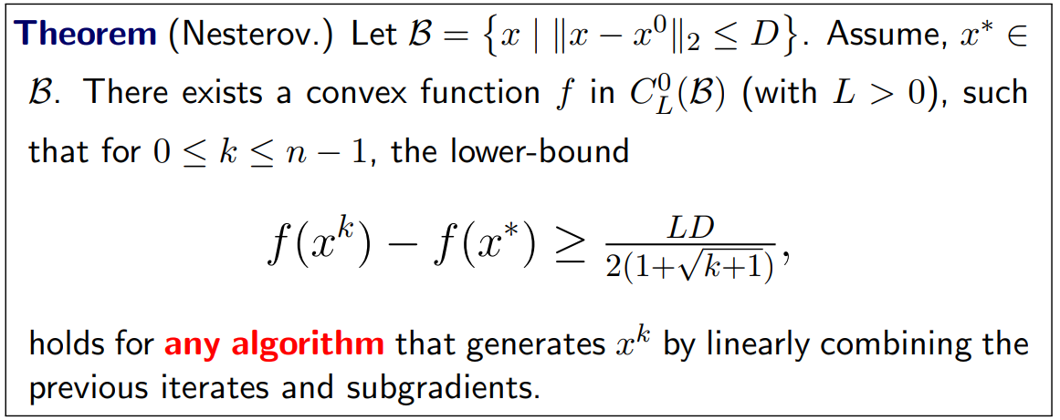
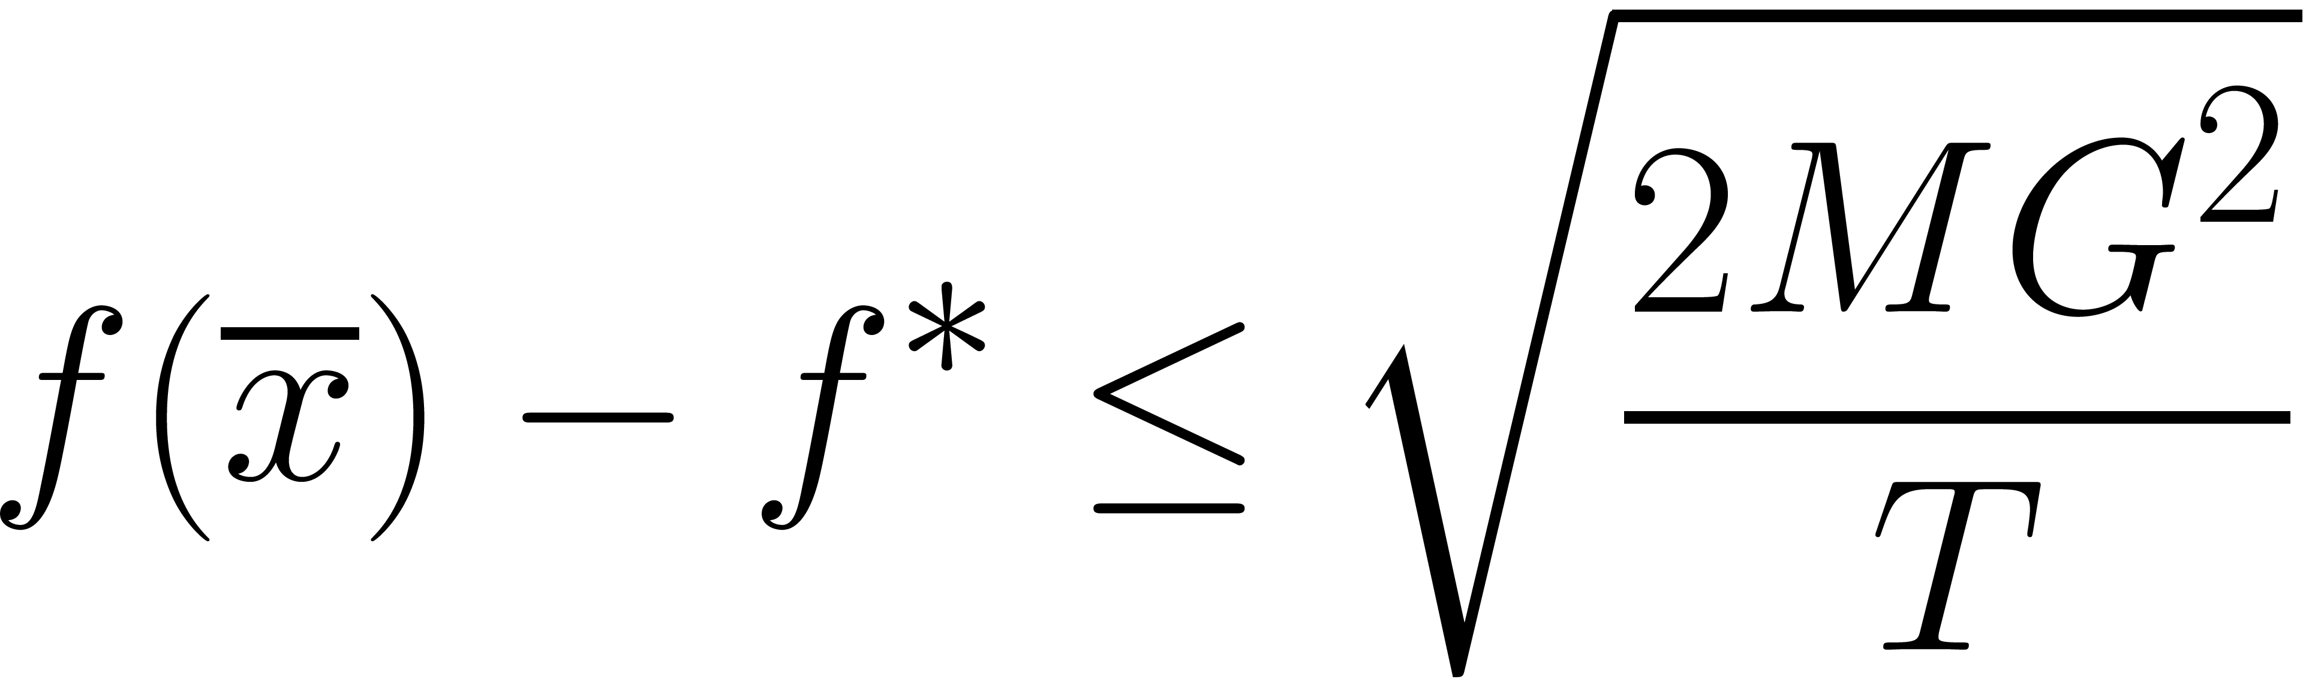
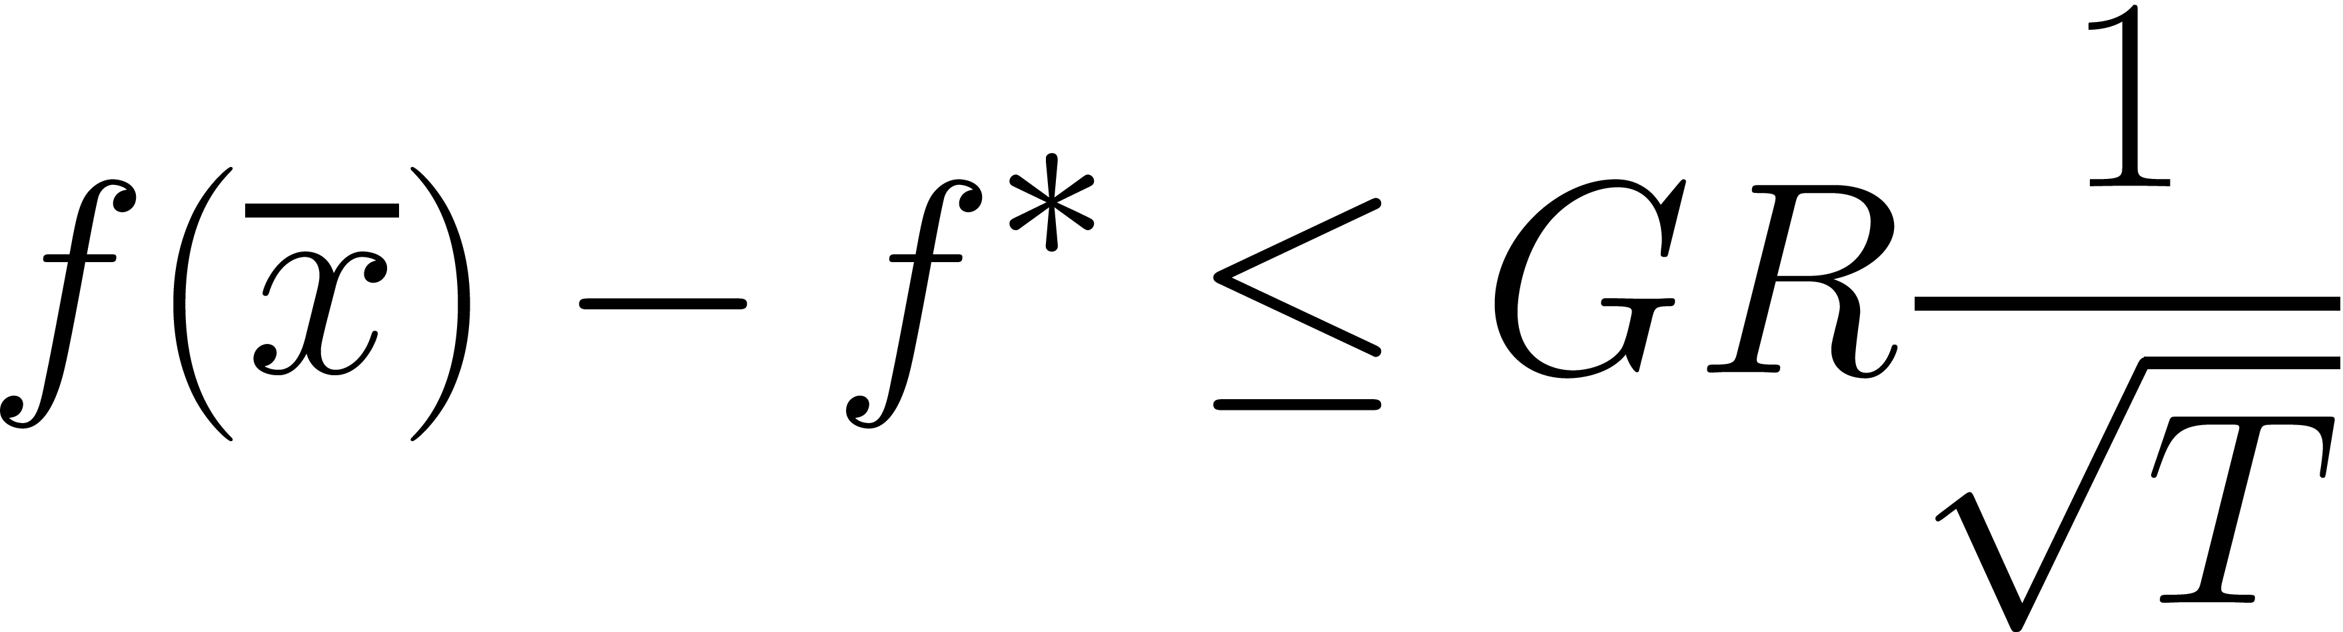
Optimal algorithm?
Means, that upper bounds for this algorithm meets lower bounds for this class of problems (convex, non-smooth optimization in our case)
Projected Subgradient Descent Mirror Descent

Slide 5
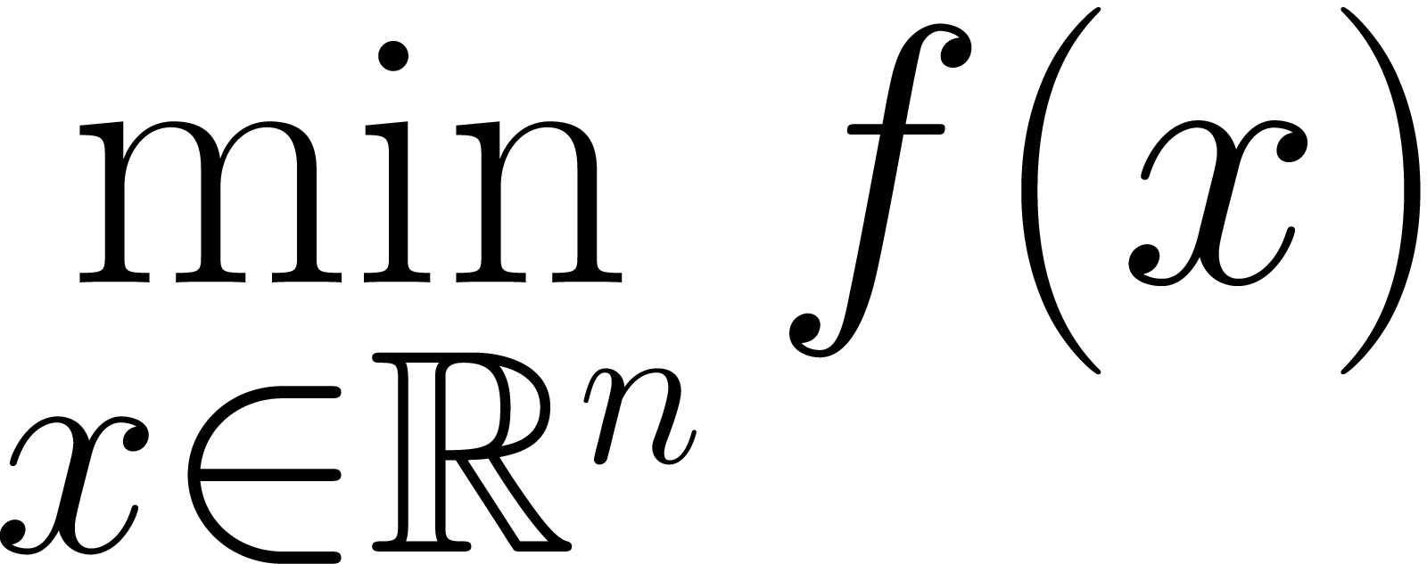
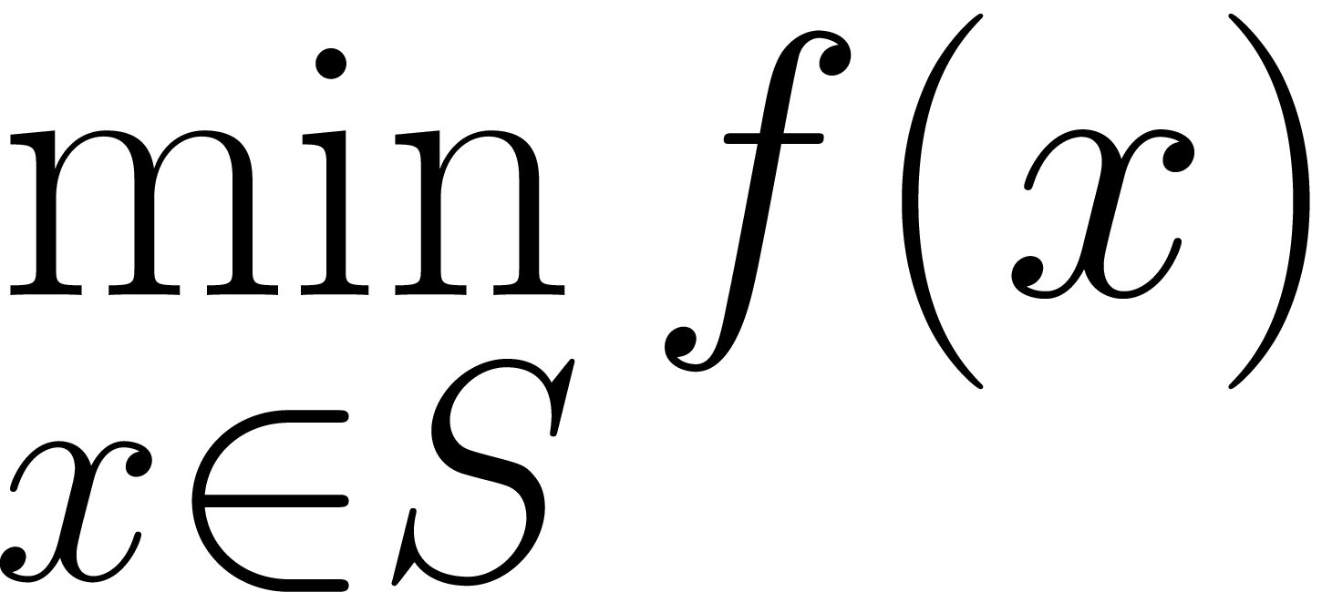
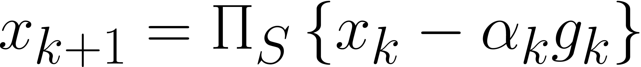
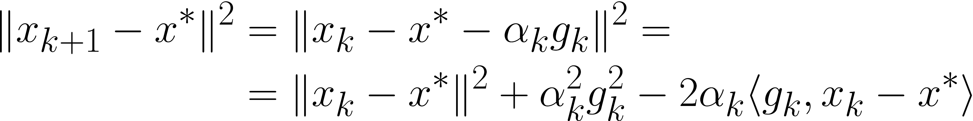
(Projected) (Sub)gradient Descent
(Sub)gradient descent
Projected subgradient descent
Bounds are usually obtained in a following way:
Notes:
Стратегии выбора шага, практика!

Slide 6
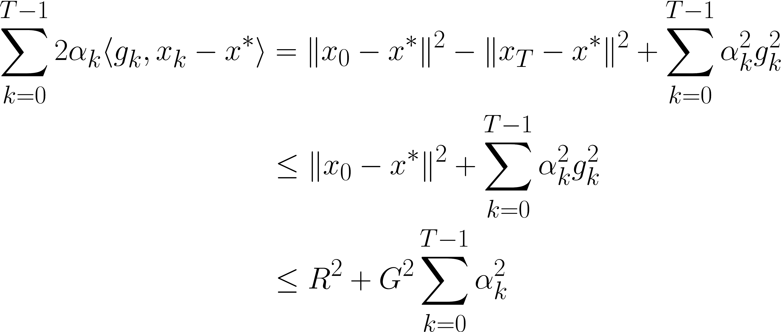
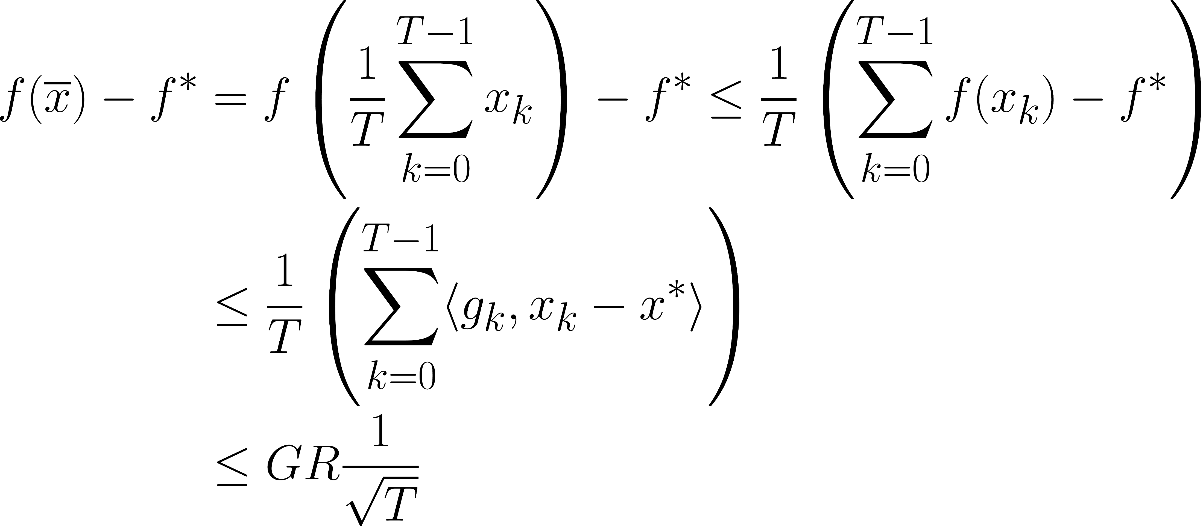
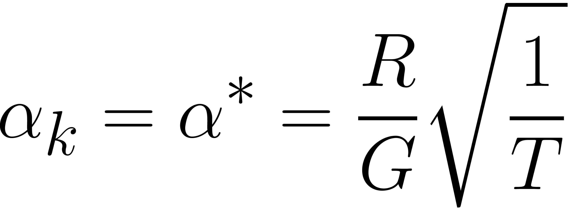
(Projected) (Sub)gradient Descent
All subgradients are bounded in our setting
Convexity
Subgradient property
Notes:
Стратегии выбора шага, практика!

Slide 7
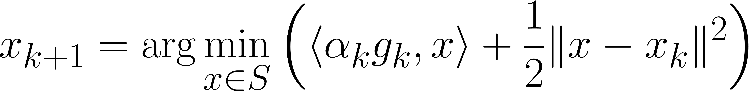
Projected Subgradient Method
First order Taylor approximation
Prox - term
The same upper bounds as for the unconditional problem!
But what if the “local geometry” is not Euclidian?
Notes:
Стратегии выбора шага, практика!

Slide 8

Mirror Descent

Slide 9
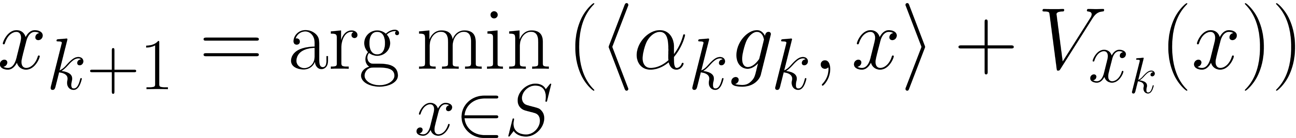
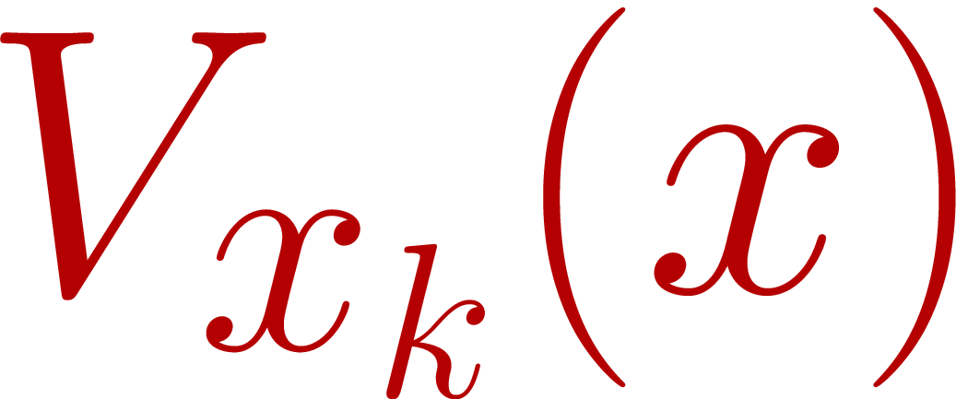
Mirror Descent
- Bregman divergence (distance) is induced by distance generating function:
Where DGF is “1” strongly convex w.r.t. primal norm
Idea: choose primal norm (with corresponding) dual norm and suitable distance function to fit the geometry of the data

Slide 10
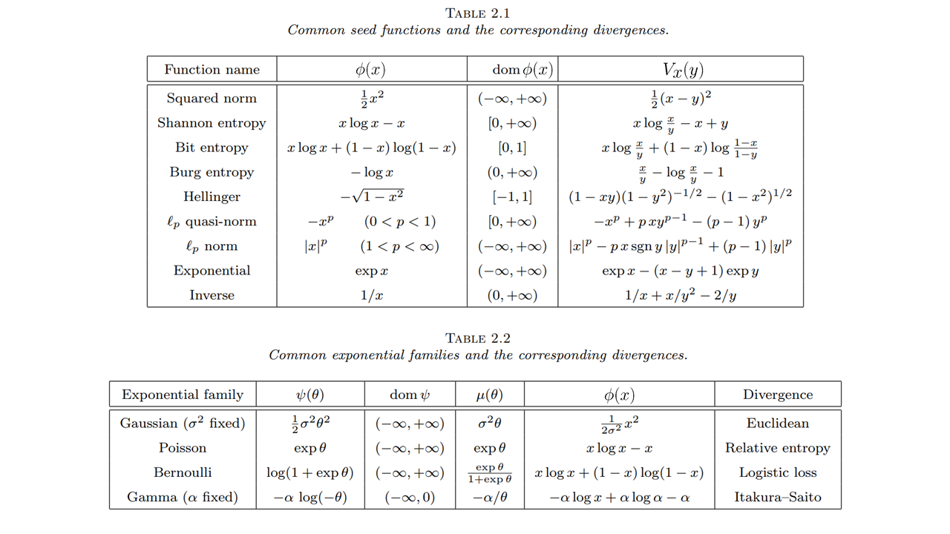
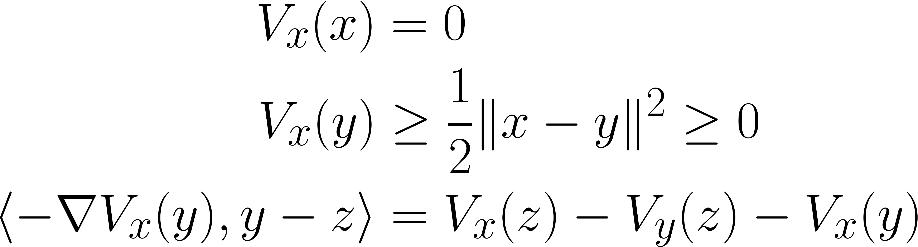
Mirror Descent
source

Slide 11
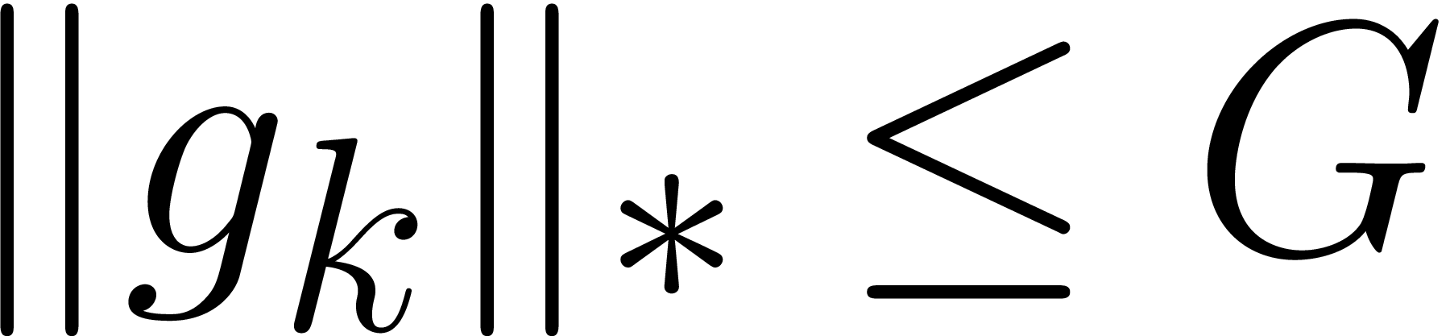
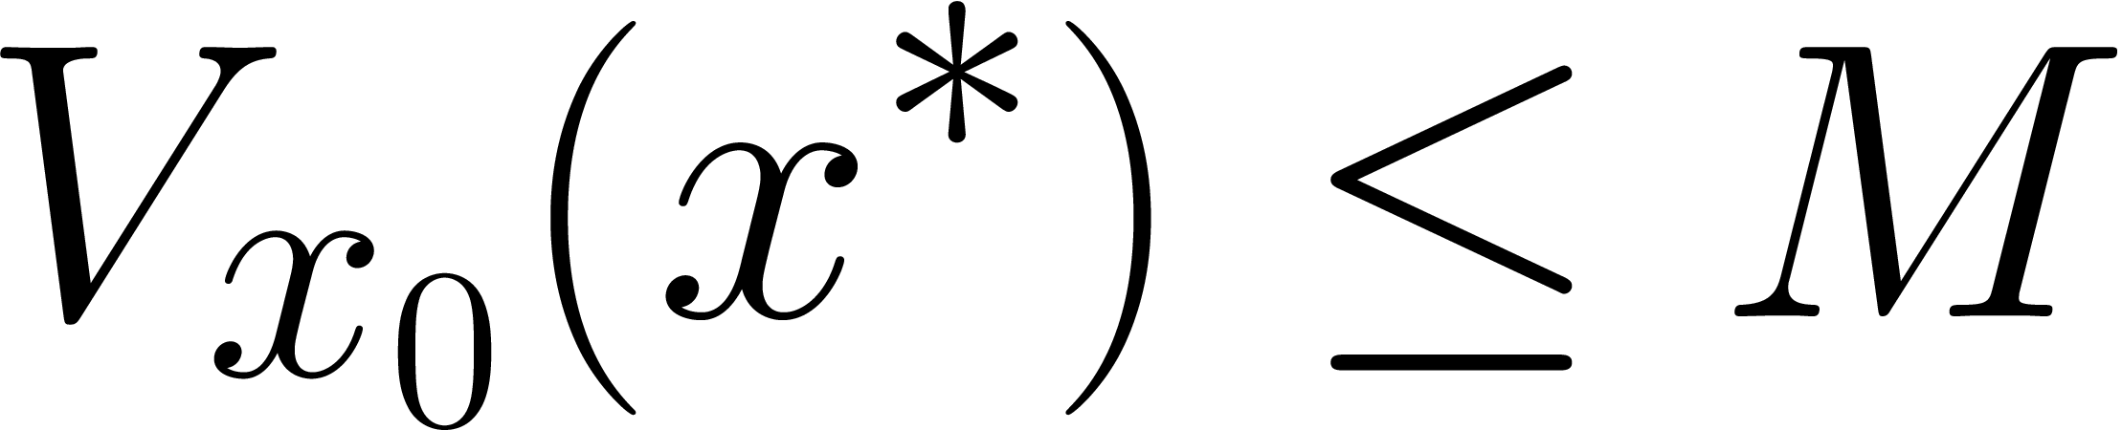
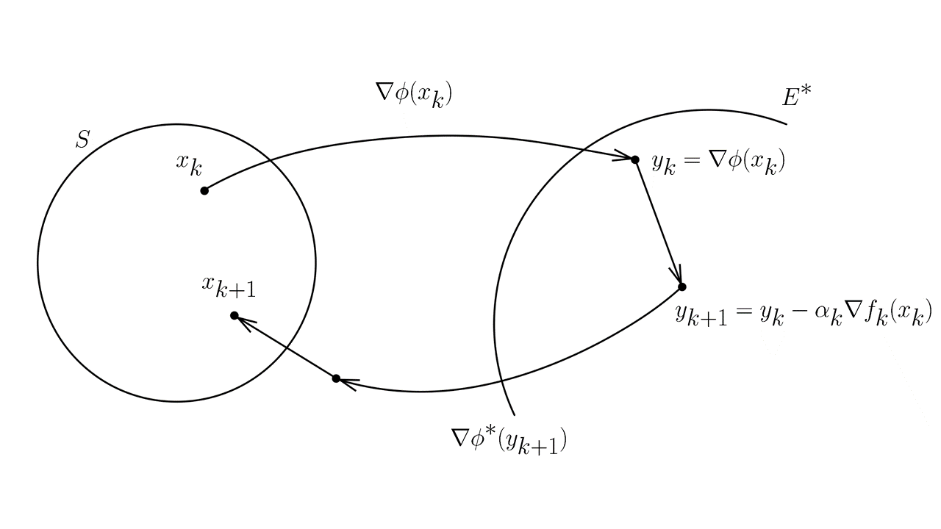
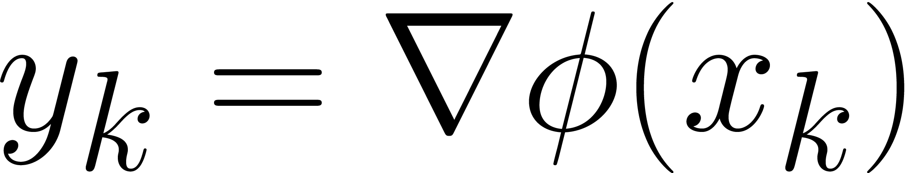
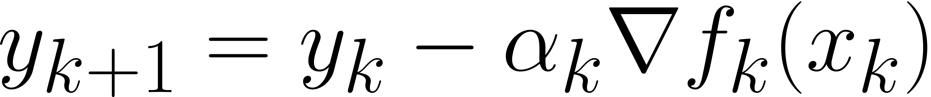
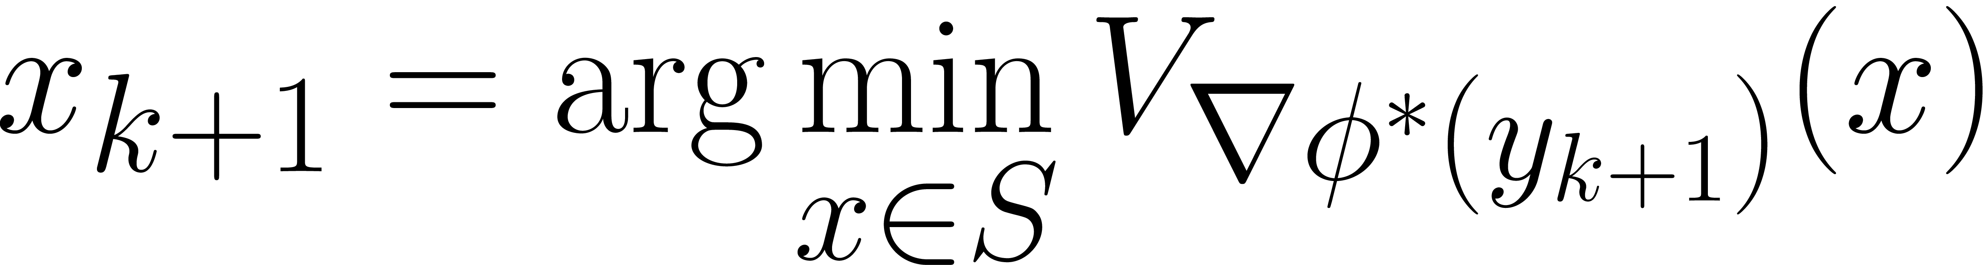
Mirror Descent
One more interpretation:
1.
2.
3.

Slide 12
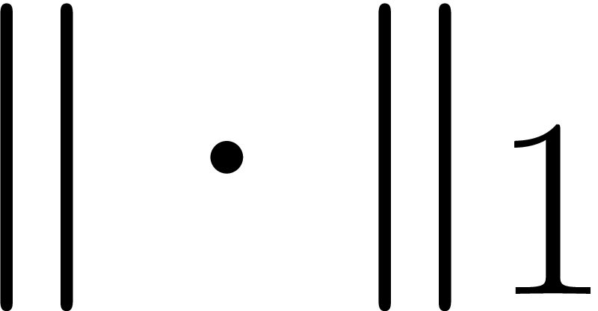

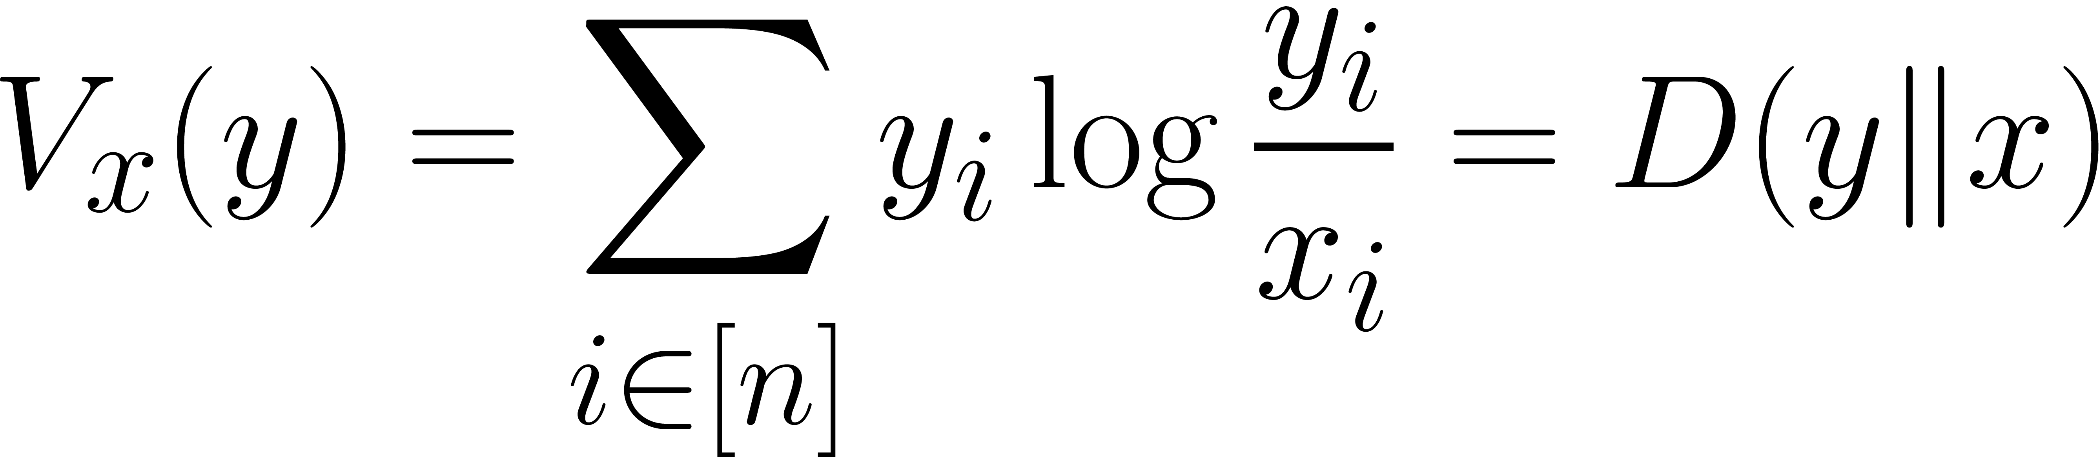
Supremacy
Consider a simple problem, where MD could outperform GD:
Choose the primal norm: , corresponding dual norm:

Slide 13
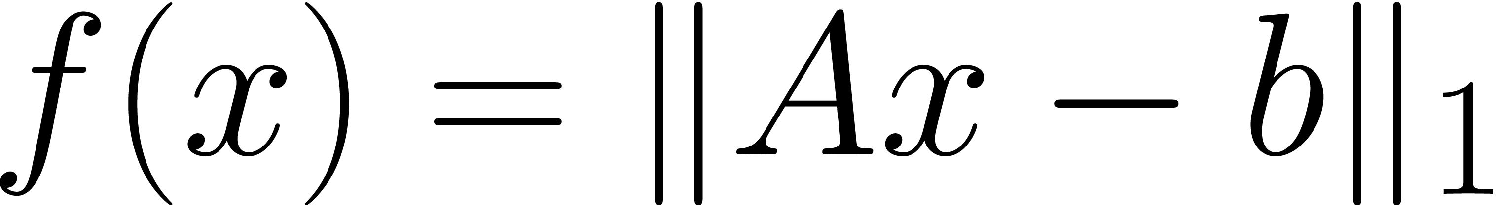
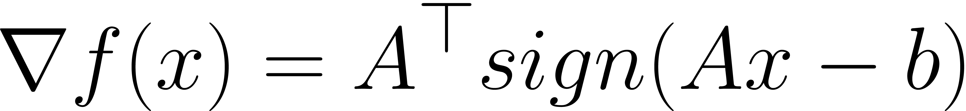
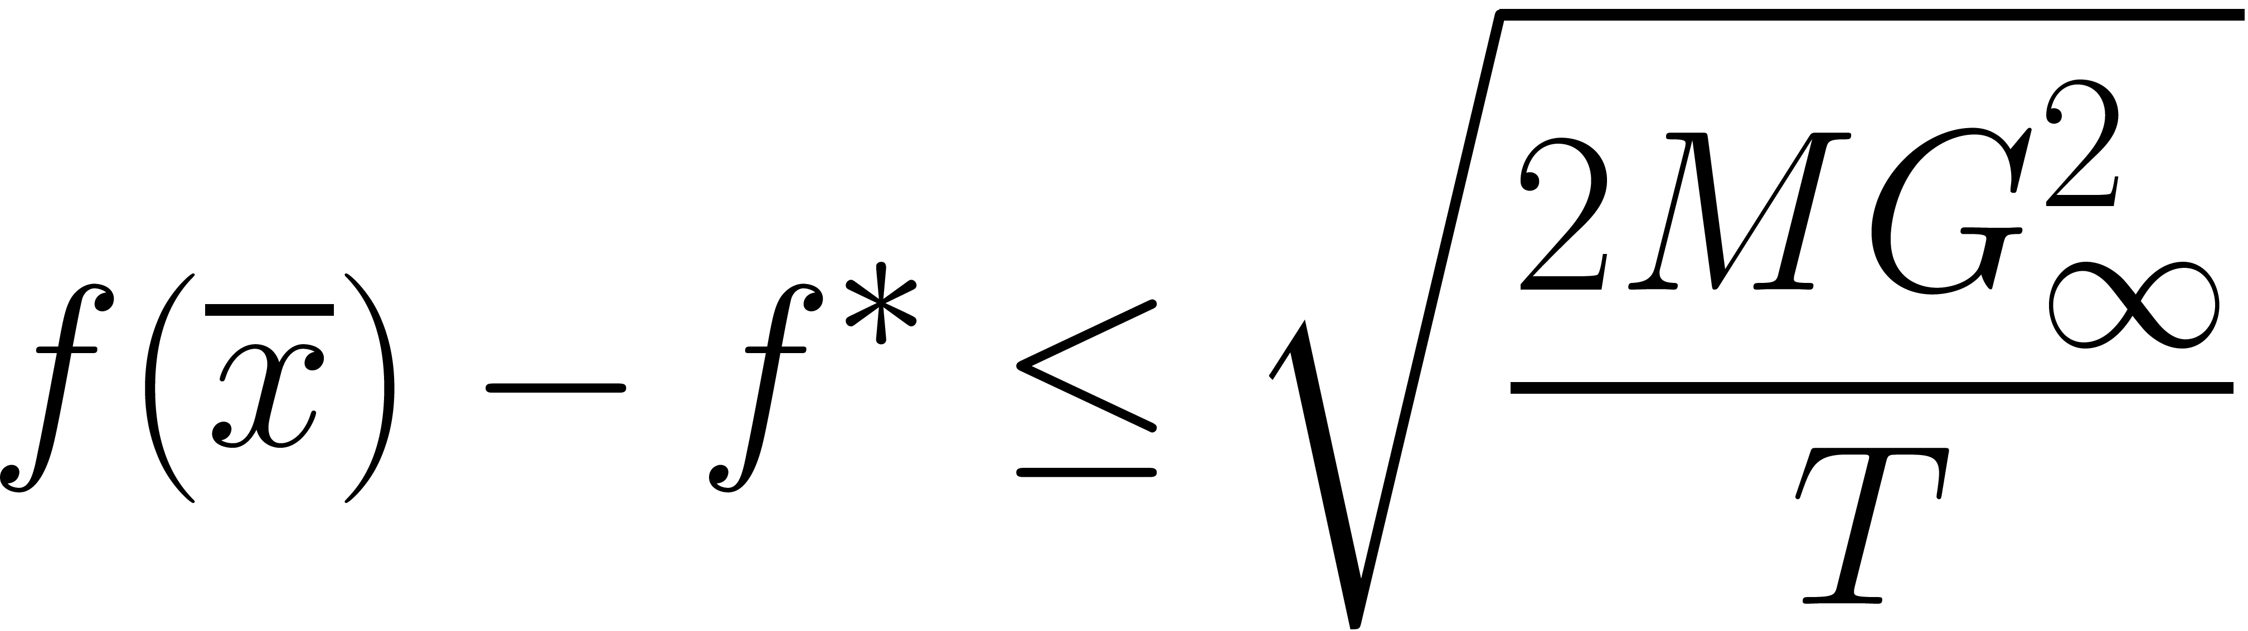
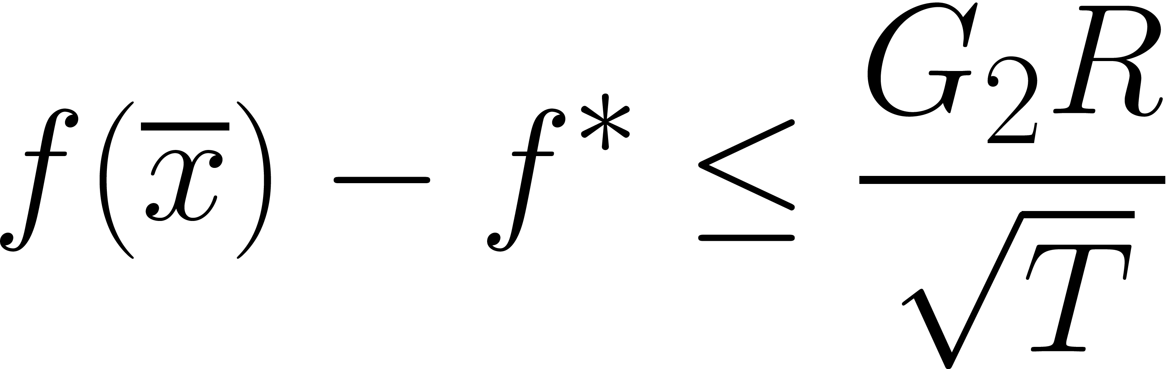
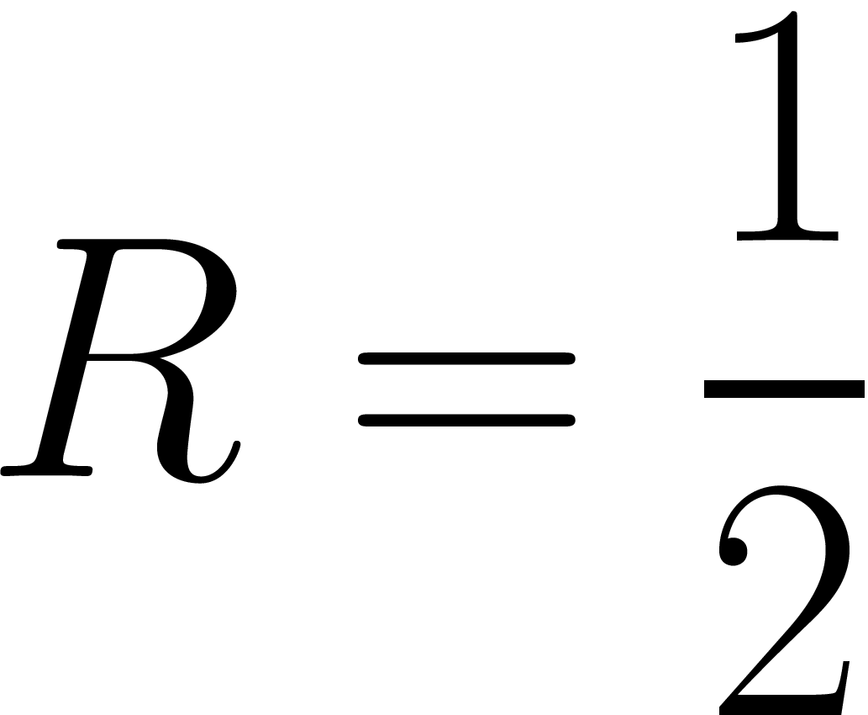
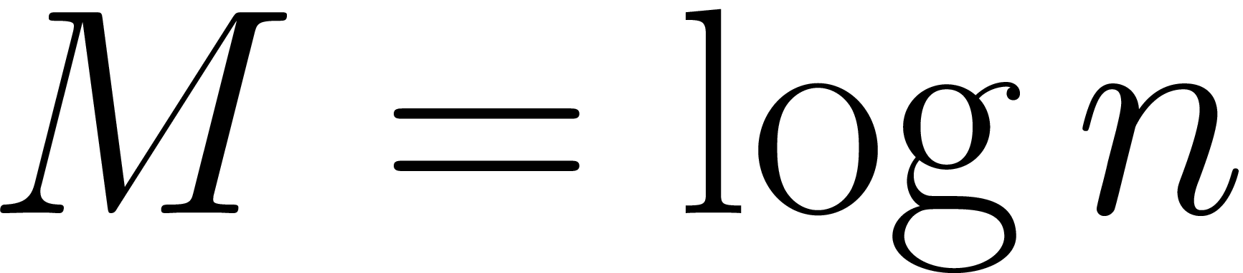
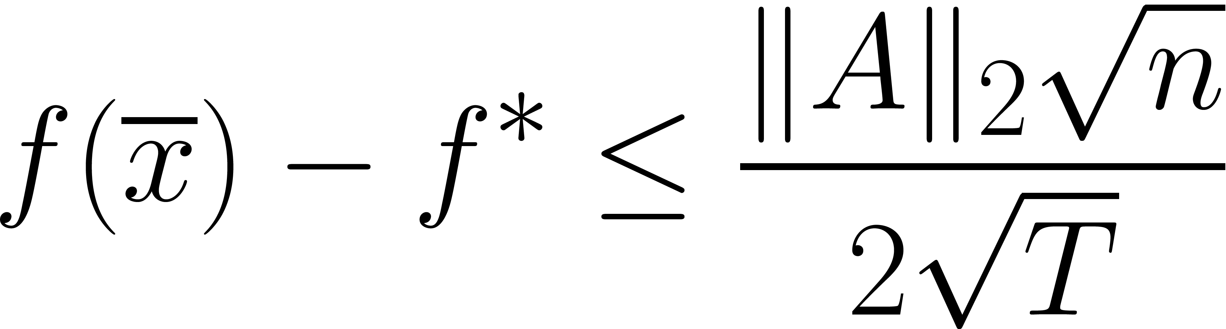
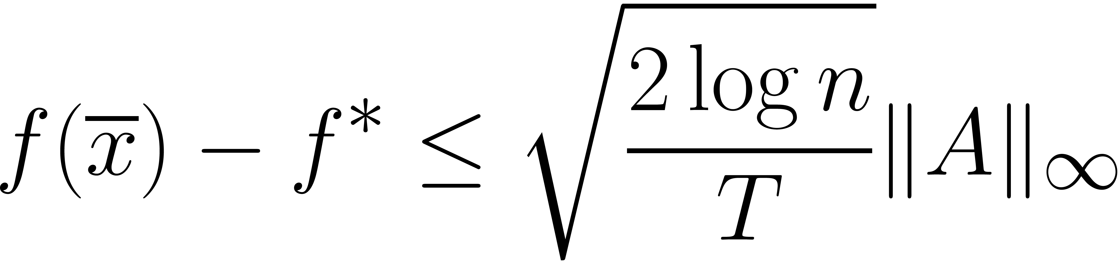
Supremacy
Let , then
GD
MD

Slide 14
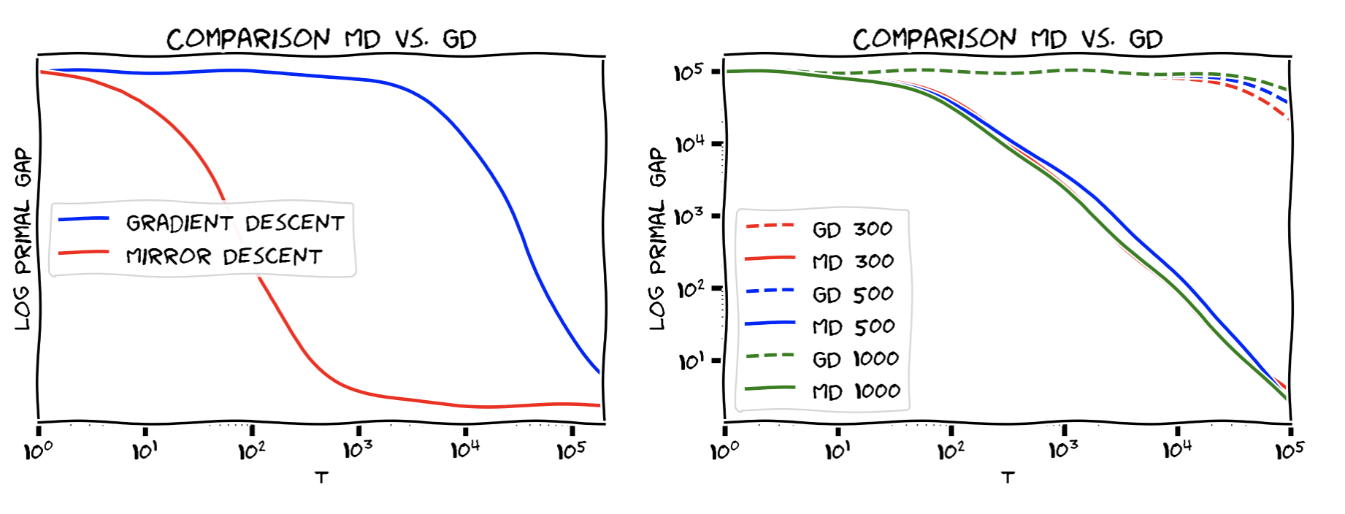
Supremacy
What internet says:

Slide 15
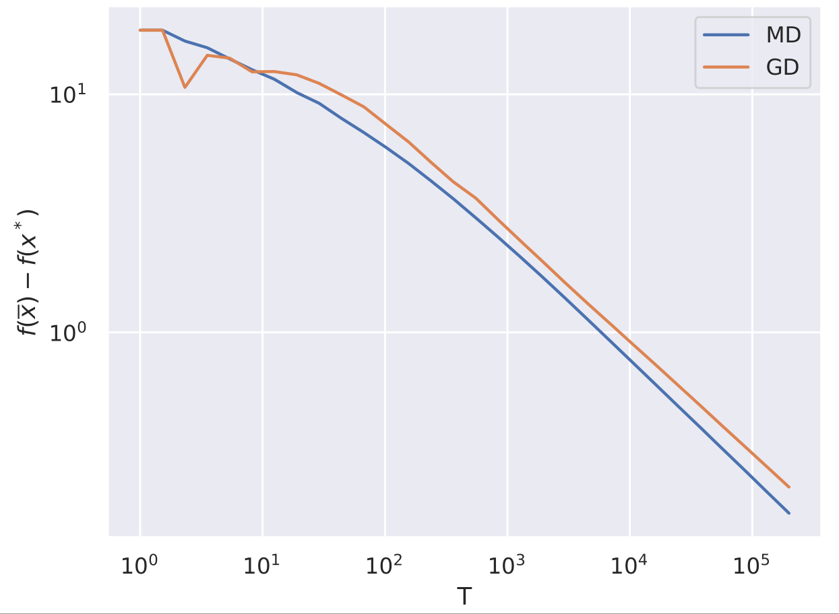
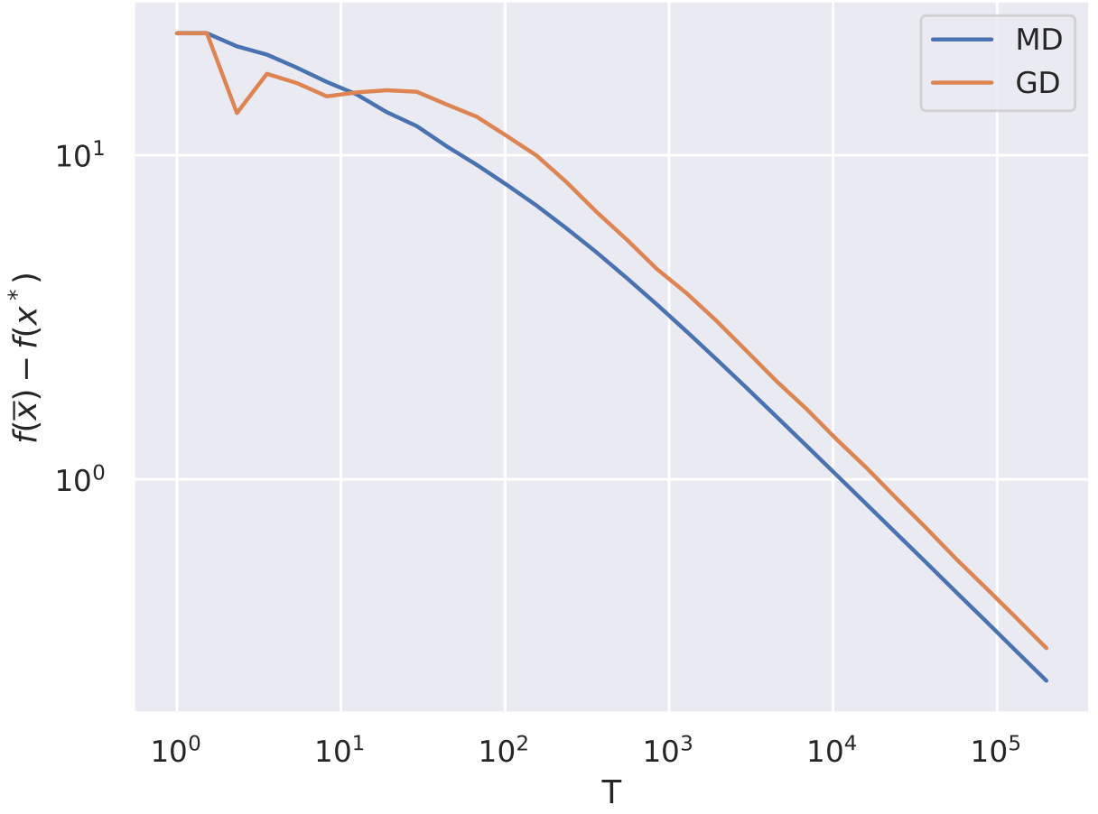
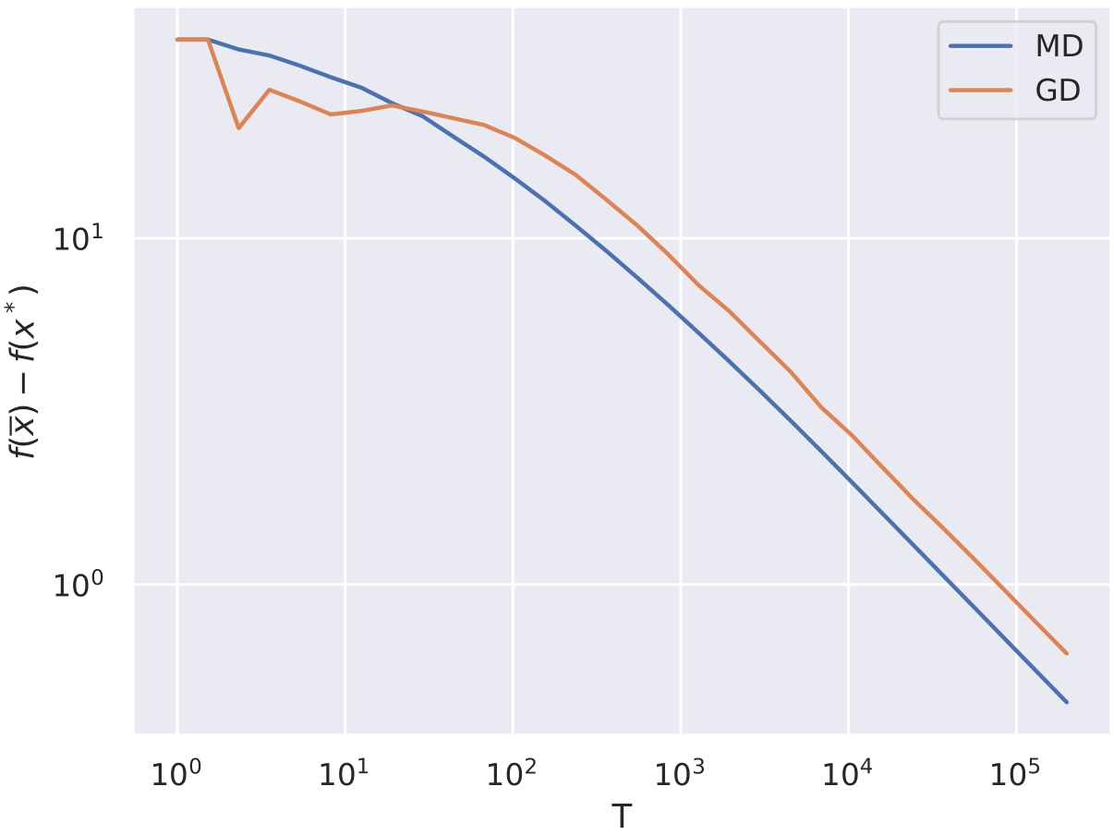
Supremacy
My experiments:
N = 300
N = 500
N = 1000

Slide 16
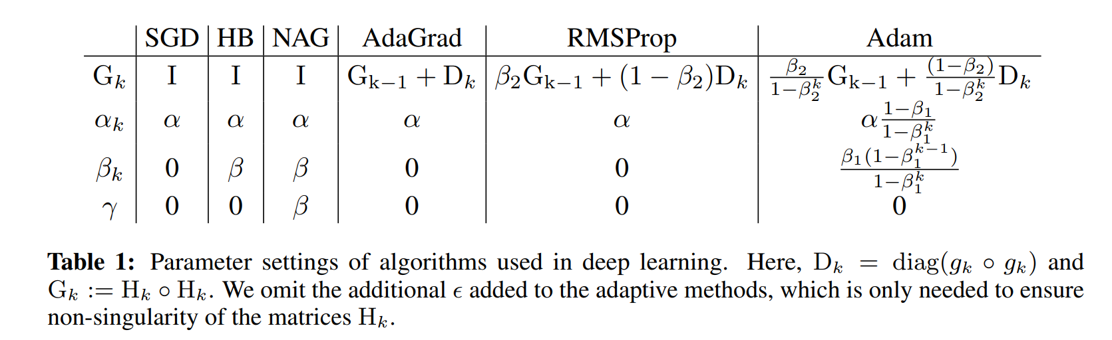
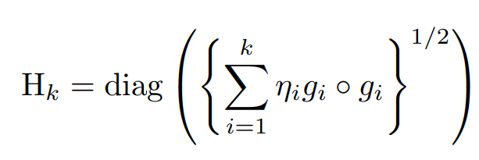
Around local metric estimation
Projected subgradient descent
(Quasi)Newton methods
Mirror Descent
Natural Gradient
Fashionable DL methods:

Slide 17
Conclusion

Slide 18
References

Slide 19
References
Cauchy, A., 1847. Méthode générale pour la résolution des systemes d’équations simultanées. Comp. Rend. Sci. Paris, 25(1847), pp.536-538.
A. Nemirovksi and D. Yudin. Problem Complexity and Method Efficiency in Optimization. John Wiley Press, 1983.
Amari, S.I., 1998. Natural gradient works efficiently in learning. Neural computation, 10(2), pp.251-276.
http://www.pokutta.com/blog/research/2019/02/27/cheatsheet-nonsmooth.html
http://www.dianacai.com/blog/2018/02/16/natural-gradients-mirror-descent/

Slide 20
References
http://www.stat.cmu.edu/~ryantibs/convexopt-S15/lectures/24-prox-newton.pdf

Slide 21
SGDR
https://arxiv.org/abs/1608.03983

Slide 22


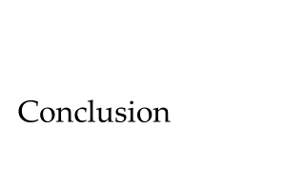
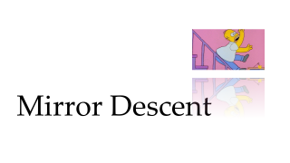
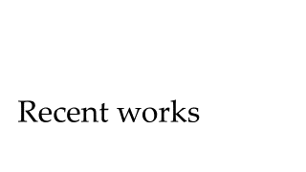
Outline

Slide 23
Problems with Adam
https://arxiv.org/pdf/1705.08292.pdf

